Slide 1
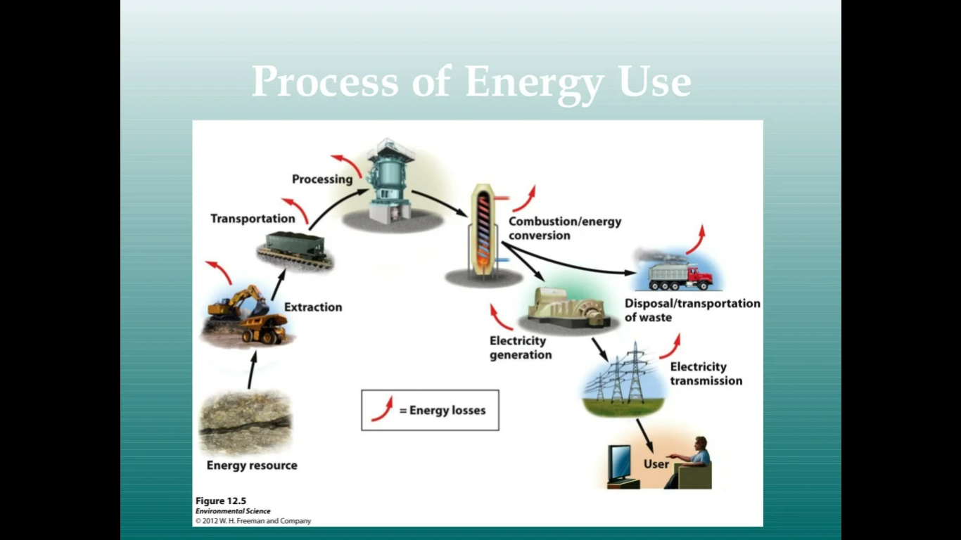

Slide 2
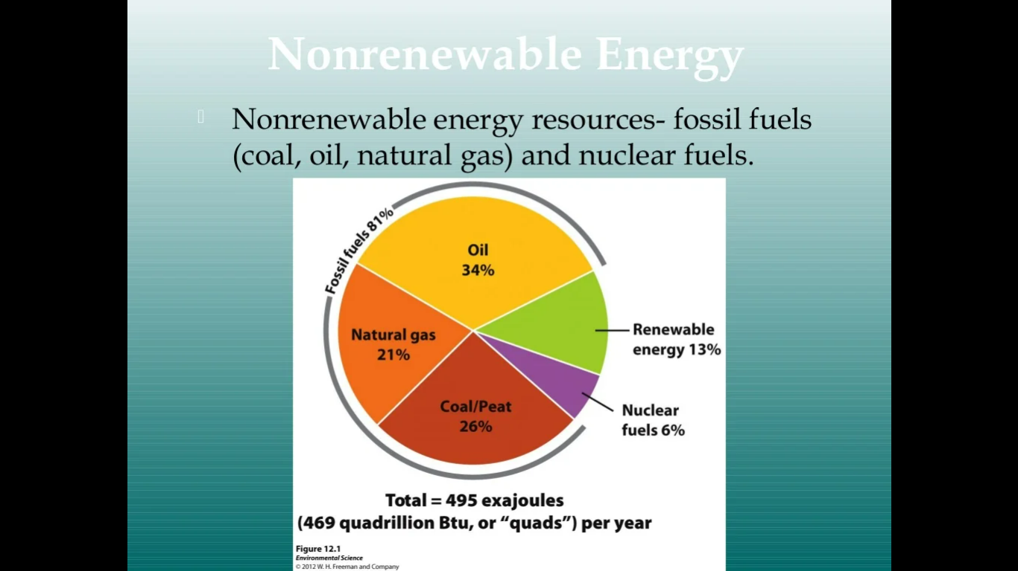

Slide 3
Energy Alternatives: The Imperative Need for Diversification
Energy is the lifeblood of modern society, powering everything from homes and industries to transportation and communication.
However, the predominant reliance on fossil fuels, primarily coal, oil, and natural gas, has led to a range of environmental, economic, and geopolitical challenges.
The urgent need for energy alternatives has emerged as a critical solution to address these issues and secure a sustainable future for our planet.
Environmental Concerns:
The burning of fossil fuels releases greenhouse gases such as carbon dioxide into the atmosphere, contributing to global warming and climate change.
This phenomenon results in rising sea levels, more frequent and severe weather events, and disruptions to ecosystems.
The pollution associated with fossil fuel extraction, transportation, and combustion also leads to air and water pollution, jeopardizing human health and biodiversity.

Slide 4
Finite Resources:
Fossil fuels are finite resources, and their depletion is inevitable.
As these resources become scarcer, their extraction becomes more expensive and environmentally damaging.
Moreover, energy scarcity can lead to geopolitical tensions, as nations compete for access to these diminishing reserves.
Energy Security:
Transitioning to energy alternatives presents economic opportunities by driving innovation, creating jobs, and fostering sustainable economic growth.
Investments in renewable energy technologies, such as solar, wind, and hydropower, can stimulate local economies and encourage research and development in emerging industries.

Slide 5
Health Benefits:
Air pollution caused by burning fossil fuels has dire consequences for public health. Respiratory diseases, cardiovascular issues, and premature deaths are linked to pollutants emitted from conventional energy sources.
Energy alternatives offer cleaner options that can significantly improve air quality and human well-being.
Technological Advances:
Advancements in renewable energy technologies have made them more efficient, affordable, and accessible.
Solar panels and wind turbines are becoming increasingly efficient at harnessing energy from natural sources.
Energy storage technologies, such as batteries, are evolving rapidly, enabling a more reliable integration of intermittent renewable sources into the grid.

Slide 6
Need for Alternatives:
Mitigating Climate Change: The adoption of energy alternatives, particularly renewable sources like solar, wind, and geothermal, can significantly reduce greenhouse gas emissions and mitigate the impacts of climate change.
By transitioning to low-carbon energy sources, we can contribute to a sustainable and habitable planet for future generations.
Resource Conservation:
Energy alternatives, unlike fossil fuels, are sustainable and abundant. Sunlight, wind, and geothermal heat are resources that will not run out in the foreseeable future.
This ensures a reliable and continuous supply of energy without contributing to resource depletion.

Slide 7
Job Creation and Economic Growth:
nvesting in energy alternatives stimulates economic growth and job creation.
The renewable energy sector offers diverse employment opportunities, ranging from manufacturing and construction to research and development.
This fosters local economic resilience and reduces dependence on fluctuating global energy markets.
Energy Security:
Diversifying energy sources enhances energy security by reducing dependence on imported fossil fuels.
Locally generated renewable energy reduces vulnerabilities to supply disruptions, geopolitical conflicts, and price fluctuations in the international energy market.

Slide 8
Improved Air Quality and Public Health:
Energy alternatives produce minimal or no emissions, leading to improved air quality and reduced health risks.
Transitioning away from fossil fuels can alleviate respiratory diseases, cardiovascular problems, and other health issues associated with pollution.
Technological Innovation:
The pursuit of energy alternatives fosters innovation in various fields, including engineering, materials science, and energy storage.
Breakthroughs in these areas have far-reaching implications beyond energy generation, driving progress in multiple industries.

Slide 9
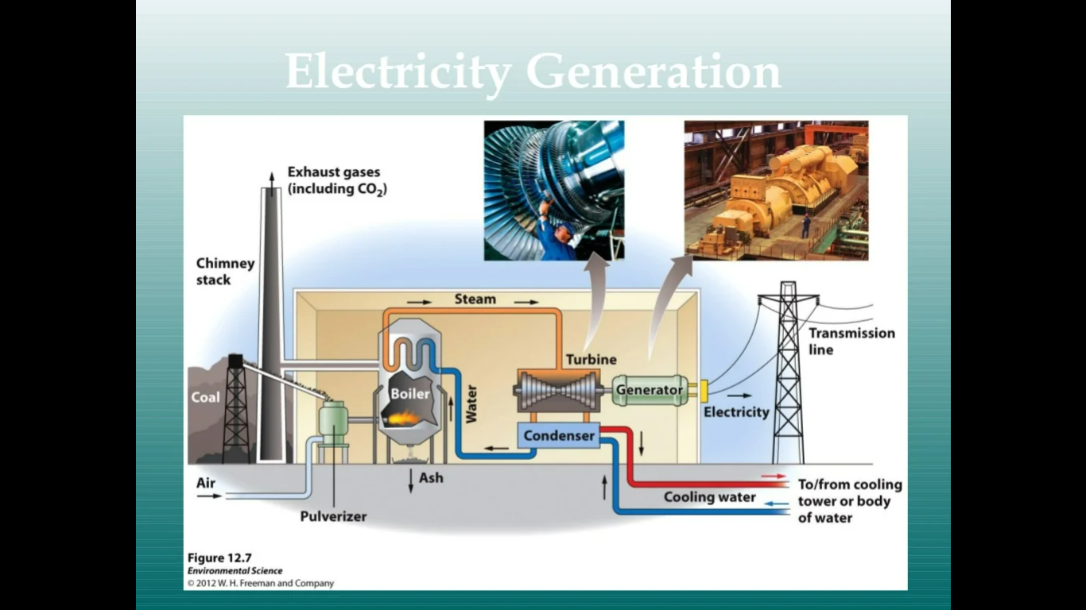

Slide 10
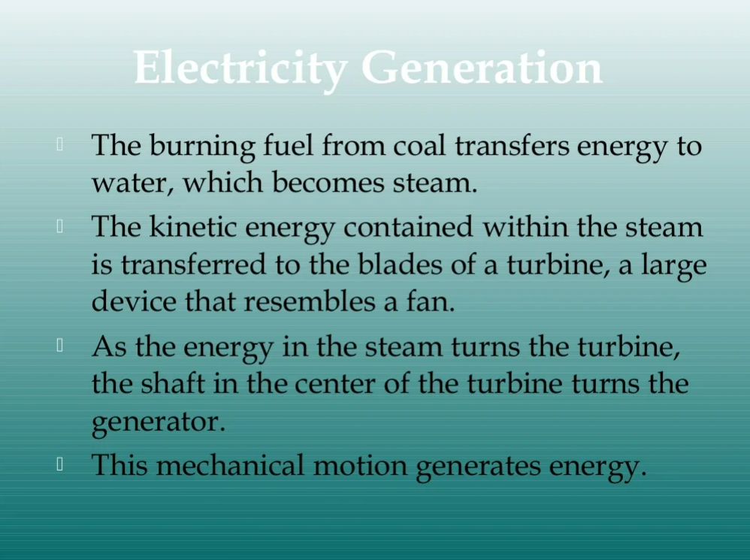

Slide 11
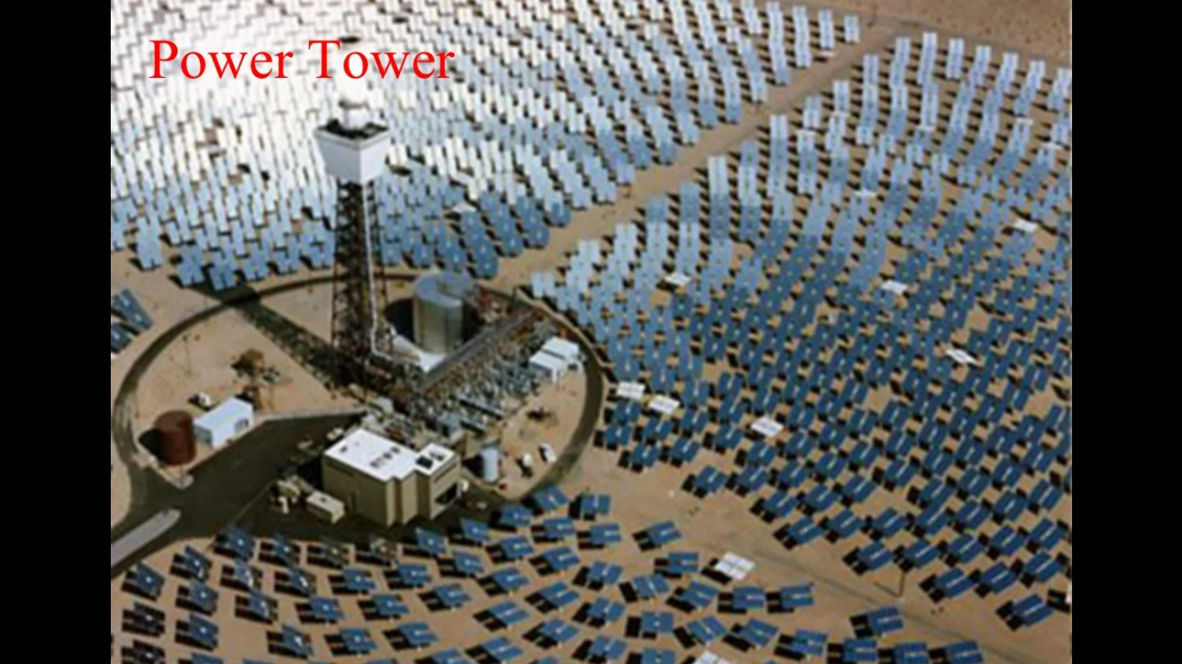

Slide 12
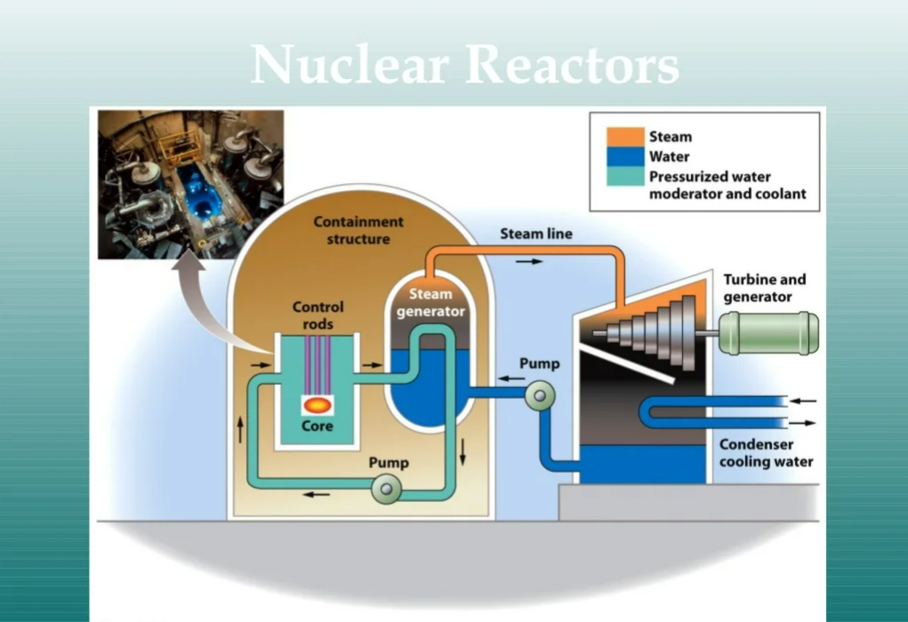

Slide 13
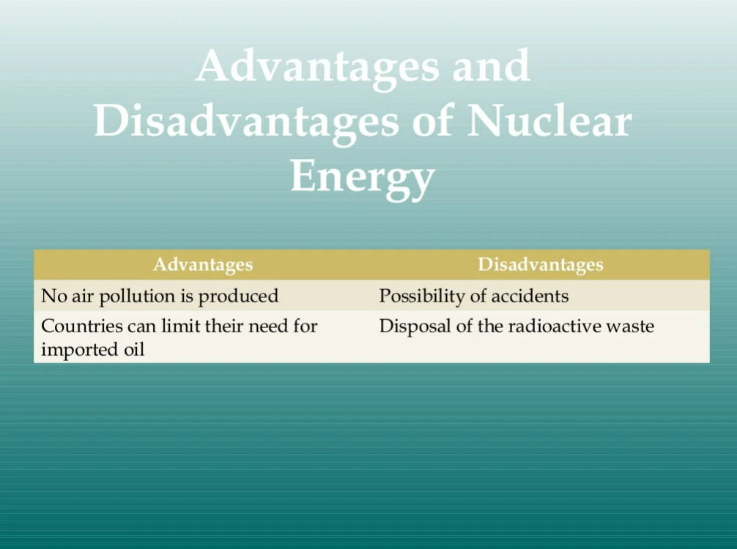

Slide 14
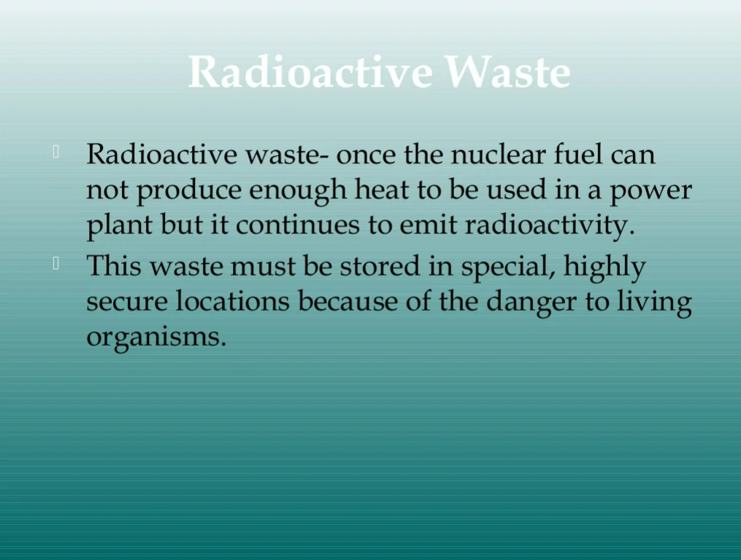

Slide 15
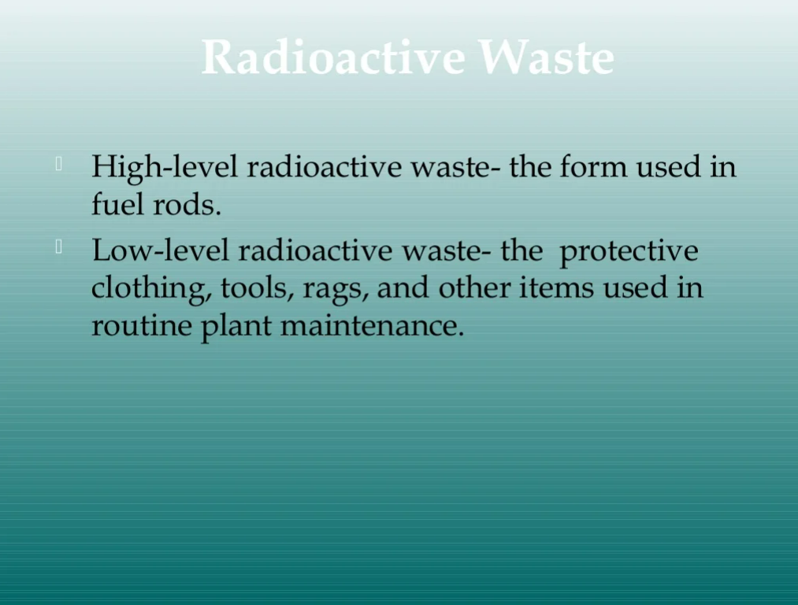

Slide 16
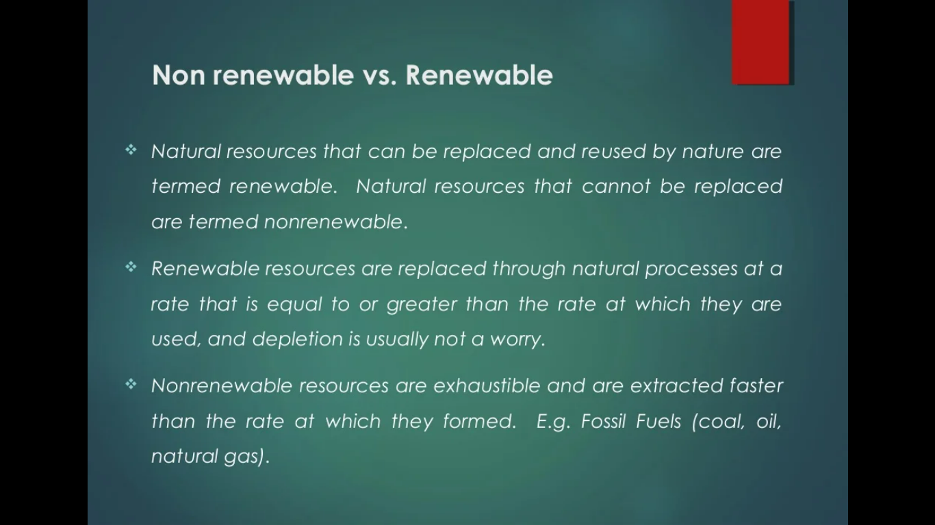

Slide 17
Energy efficiency
Energy efficiency is the process of reducing the amount of energy required to provide products and services. For example, insulating a building allows it to use less heating and cooling energy to achieve and maintain a thermal comfort.
Energy-efficient LED light bulbs are able to produce the same amount of light as incandescent light bulbs by using 75 to 80 percent less electricity.

Slide 18
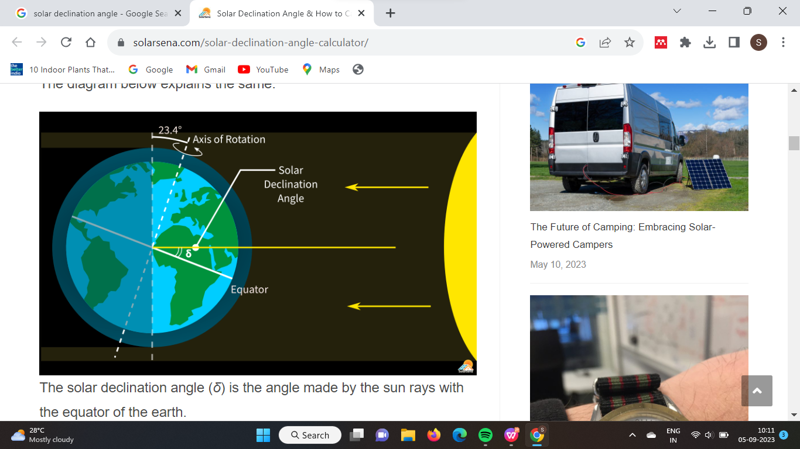
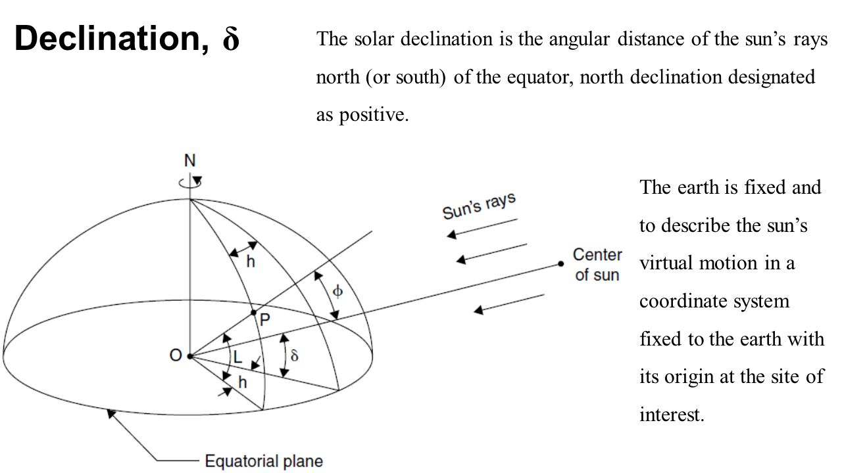
Solar declination is defined as the angle between the line joining the centers of the Sun and the Earth and its projection on the equatorial plane.

Slide 19
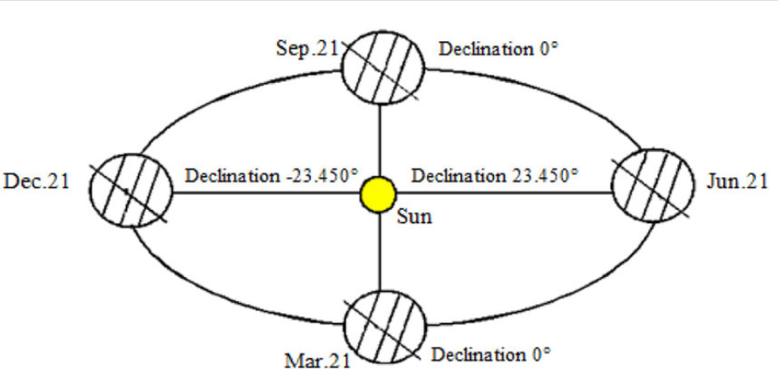

Slide 20
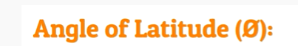
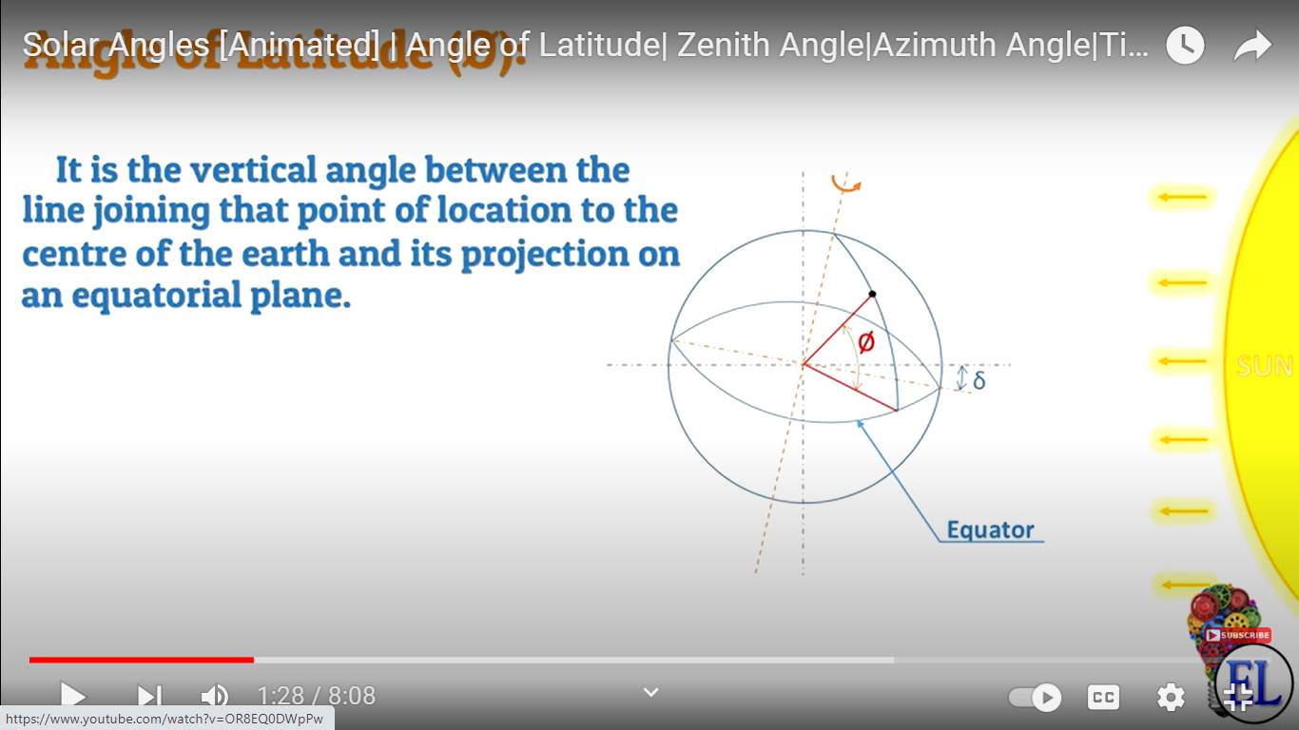

Slide 21
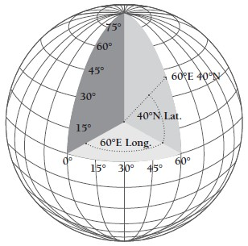
+ in the north pole
- in the south pole

Slide 23
Zenith angle is +90 degrees during sun rise
-90 degrees during sun set

Slide 27
Solar Elevation Angle (Altitude): This angle measures the height of the Sun above the horizon as observed from a specific location on Earth. It ranges from 0° (on the horizon) to 90° (directly overhead). Higher values indicate the Sun is higher in the sky, leading to more direct sunlight and potentially higher temperatures.
Solar Azimuth Angle: This angle defines the direction of the Sun relative to the observer's location. It is measured clockwise from true north. A solar azimuth angle of 0° indicates the Sun is due north, 90° means it's due east, 180° is due south, and 270° is due west.
Solar Declination Angle: This angle measures the latitude at which the Sun's rays are perpendicular to the Earth's surface. It changes throughout the year as the Earth orbits the Sun, causing the seasons. The solar declination angle is 0° during the equinoxes, positive during the northern hemisphere's summer, and negative during its winter.

Slide 28
Hour Angle: This angle measures the time since solar noon, which is the time when the Sun is at its highest point in the sky. It is often expressed in degrees, with 15° per hour of time.
Inclination of Earth's Axis: Earth's axis is tilted relative to its orbital plane around the Sun. This tilt is responsible for the changing seasons as different parts of the Earth receive varying amounts of sunlight throughout the year. The axial tilt is approximately 23.5°.
Angle of Incidence: This angle refers to the angle at which sunlight strikes a surface. The more direct the sunlight, the smaller the angle of incidence, resulting in more concentrated energy per unit area.

Slide 29
Solar Photovoltaic Technology.
Passive Solar Technology.
Solar Water Heating.
Solar Process Heat.
Concentrating Solar Power.

Slide 30
